Slide 1
Lab 3.5
PRODUCT MANAGER VALIDATION AND EXCEPTION HANDLING & CARDLAYOUT

Slide 2
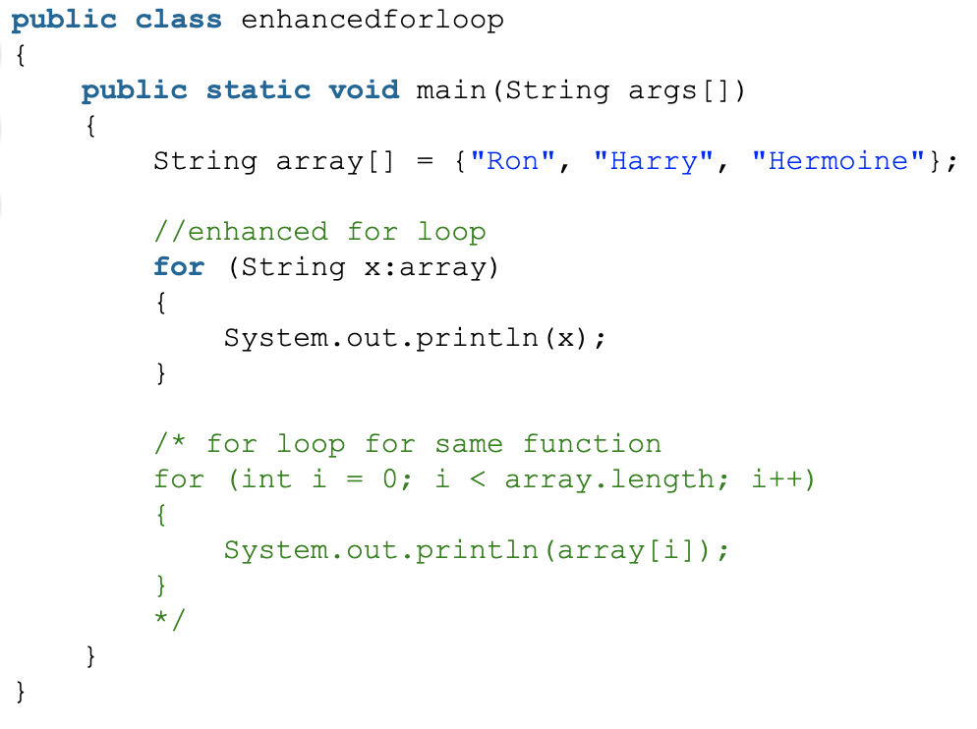
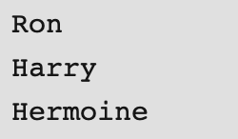
Loops – For loop
Output:

Slide 3

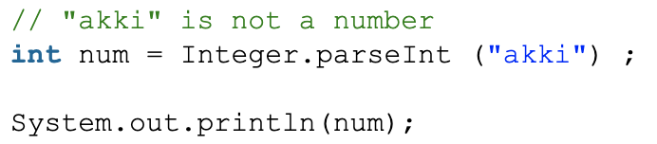
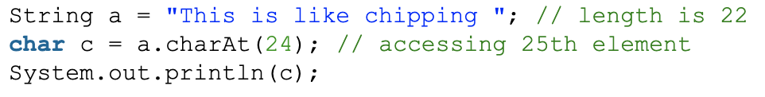
Exception
1. NullPointer Exception
2. NumberFormat Exception
3. StringIndexOutOfBound Exception

Slide 4
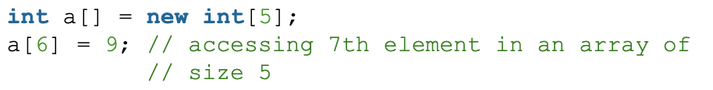
Exception
4. ArrayIndexOutOfBounds Exception
Other Exceptions: ClassNotFoundException,
FileNotFoundException,
IOException,
NoSuchMethodException, etc.

Slide 5
Validation and Exception Handling
Data validation:
Checking the data before performing operations that could fail, for example check for 0 before doing a division.
Exception handling:
Well defined behavior if an operation fail, for example if a database query times out.

Slide 6
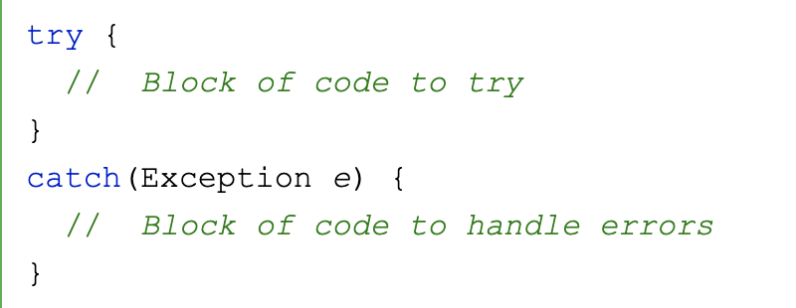
Validation and Exception Handling
Try ... Catch …
The try statement allows you to define a block of code to be tested for errors while it is being executed.
The catch statement allows you to define a block of code to be executed, if an error occurs in the try block.
The try and catch keywords come in pairs:

Slide 7
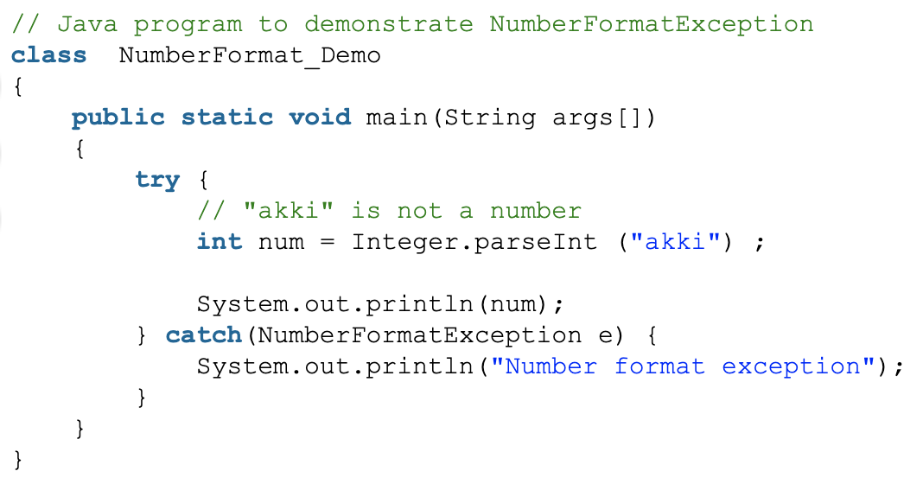
Validation and Exception Handling
Try ... Catch … Examples
1. NumberFormat Exception

Slide 8
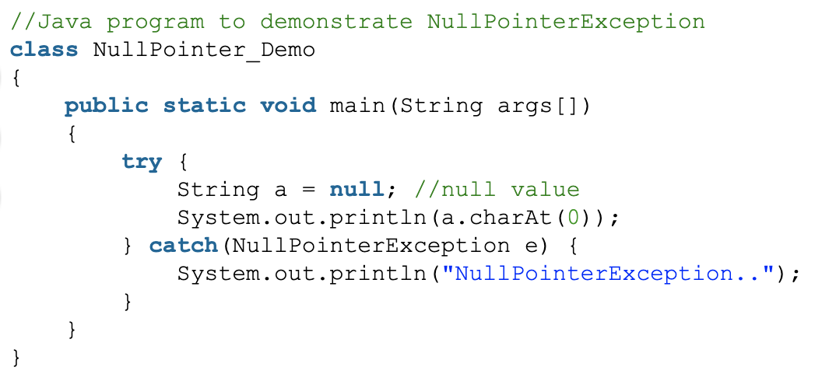
Validation and Exception Handling
Try ... Catch … Examples
1. NullPointer Exception

Slide 9
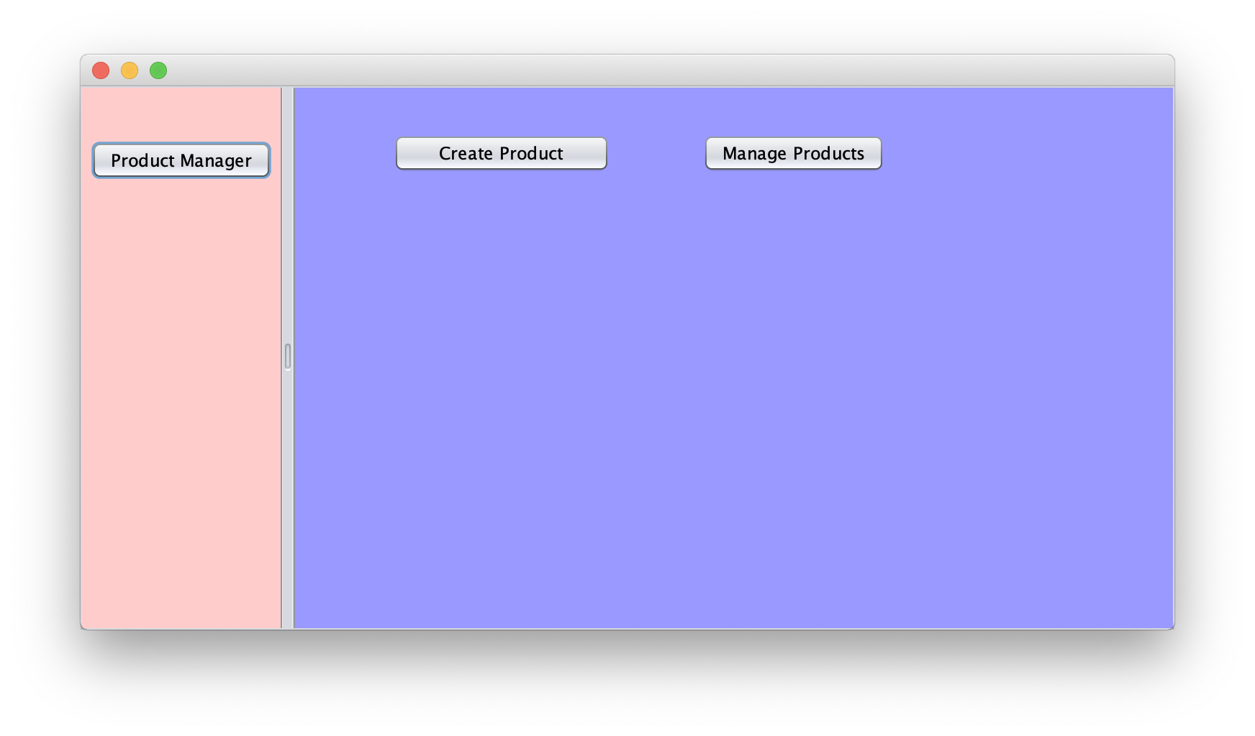
Product Manager App

Slide 10
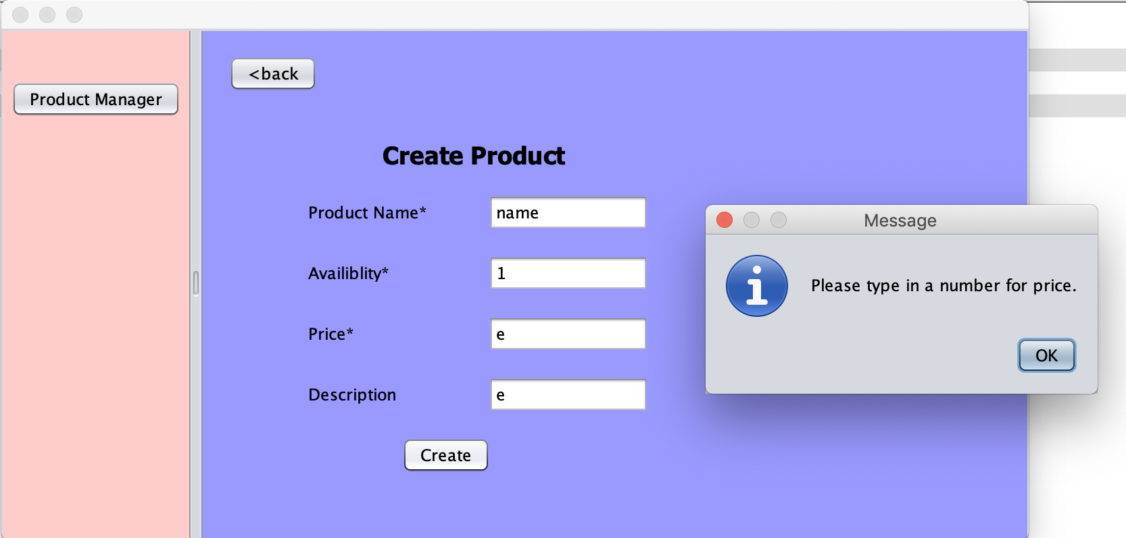
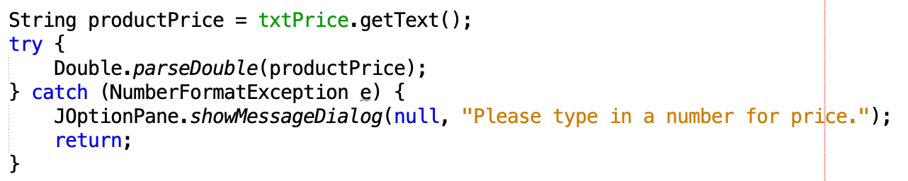
Product Manager App – Validation

Slide 11
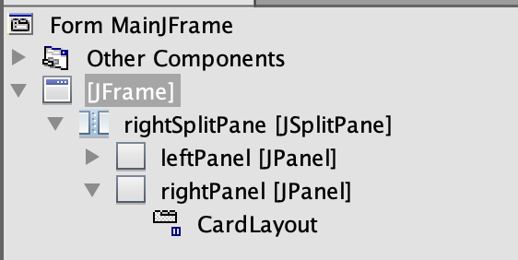
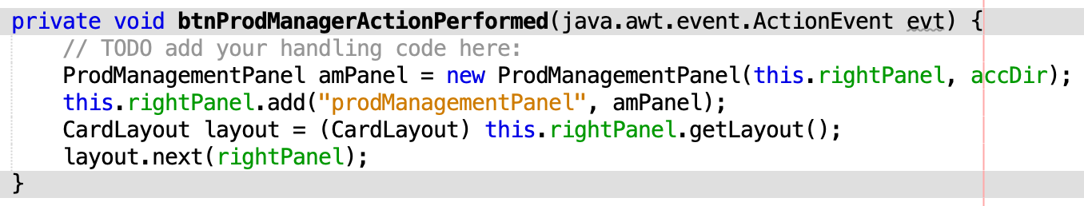
Product Manager App - CardLayout

Slide 12
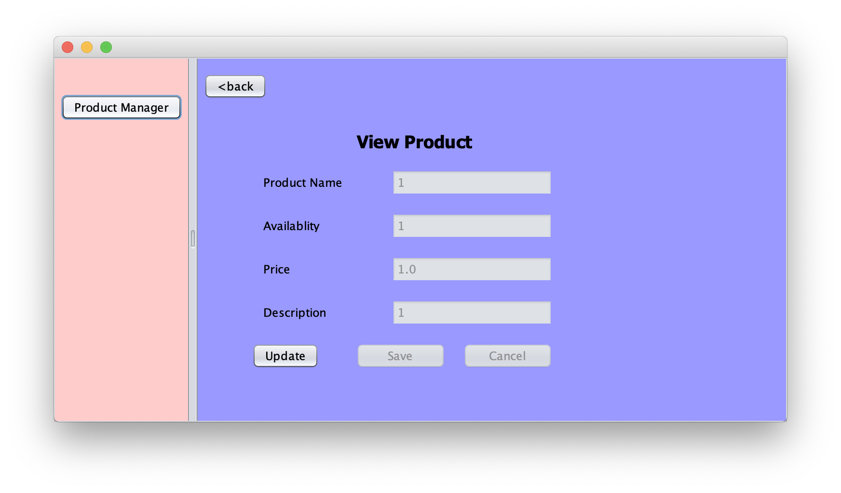
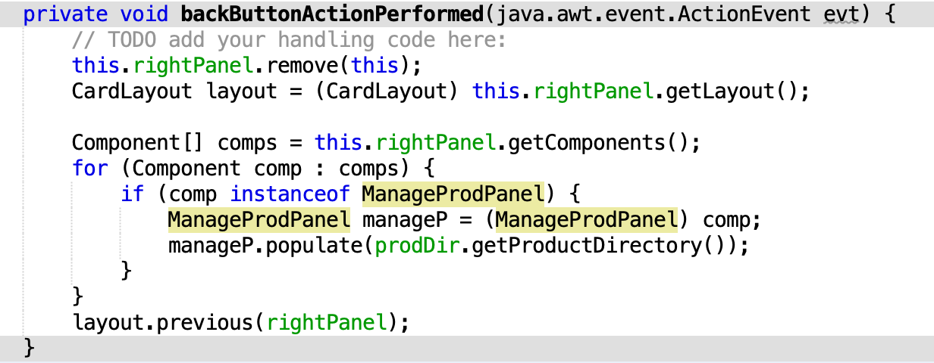
Product Manager App – Back Button

Slide 13
Git for Group
Git workflow:
https://jc-downloads.s3.amazonaws.com/git-team-cheatsheet.pdf
Create Bitbucket team:
https://confluence.atlassian.com/get-started-with-bitbucket/create-a-team-861176360.html

Slide 14
Homework
This is an individual assignment.
Implement the functionality of searching by product name, your search result should be shown in “tblDirectory” JTable.
Create back buttons and implement a “back” functionality on both “ManageProdPanel” and “ViewPanel”
Link your JPanels by using CardLayout.
Validate your inputs and handle exceptions for “create” and “update”.
Multiple small git commits.
.gitignore file is required. https://www.atlassian.com/git/tutorials/saving-changes/gitignore
Due Date: Sat, Oct 5th, 11:59pm on BitBucket

